Slide 1
MA3077 (DLI) Operational Research Lecture 5&6 – Feasibility and duality in linear programming
Dr Neslihan Suzen

Slide 2
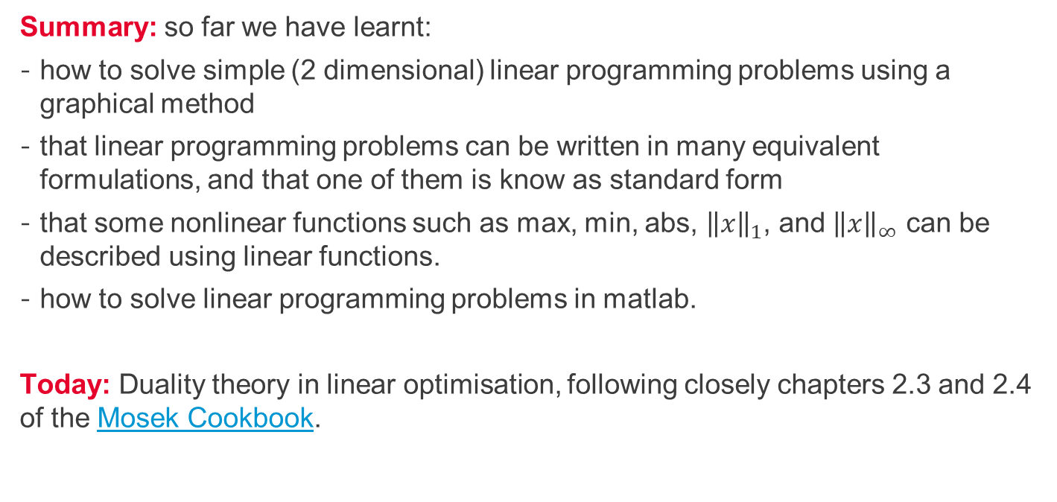
Recap and lecture outline
Summary: so far we have learnt:
how to solve simple (2 dimensional) linear programming problems using a graphical method
that linear programming problems can be written in many equivalent formulations, and that one of them is know as standard form
that some nonlinear functions such as max, min, abs, ${\left\|x\right\|}_{1}$, and ${\left\|x\right\|}_{∞}$ can be described using linear functions.
how to solve linear programming problems in matlab.
Today: Duality theory in linear optimisation, following closely chapters 2.3 and 2.4 of the Mosek Cookbook.

Slide 3
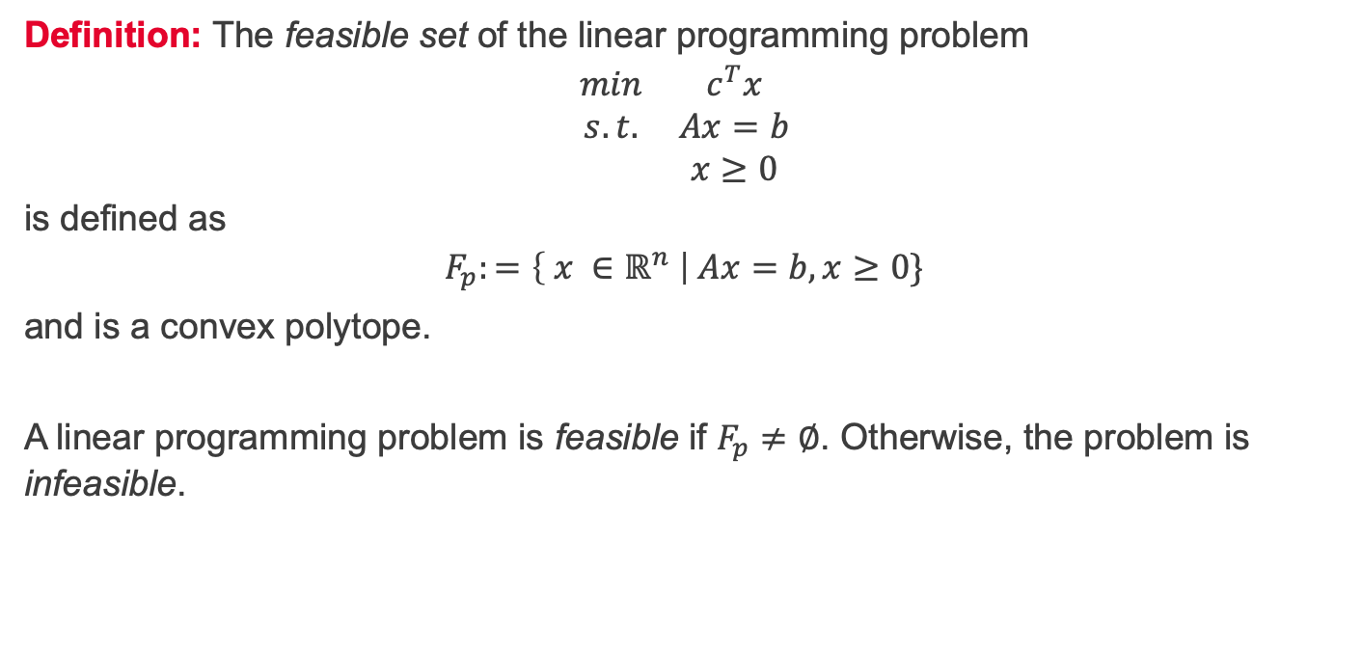
Feasible set
Definition: The feasible set of the linear programming problem
$$\begin{matrix}min & c^{T}x \\ s.t. & Ax=b \\ & x≥0\end{matrix}$$
is defined as
$$F_{p}:=\left\{ x ∈ℝ^{n} \right| Ax=b, x≥0\}$$
and is a convex polytope.
A linear programming problem is feasible if $F_{p}≠∅$. Otherwise, the problem is infeasible.

Slide 4
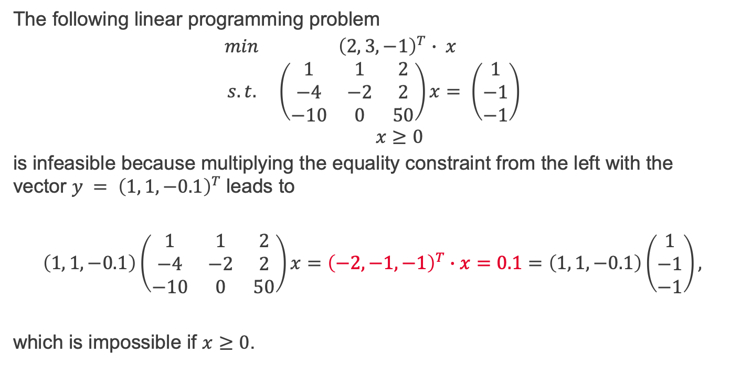
Example of an infeasible problem
The following linear programming problem
$$\begin{matrix}min & {\left(2, 3, −1\right)}^{T}∙ x \\ s.t. & \left(\begin{matrix}1 & 1 & 2 \\ −4 & −2 & 2 \\ −10 & 0 & 50\end{matrix}\right)x= \left(\begin{matrix}1 \\ −1 \\ −1\end{matrix}\right) \\ & x≥0\end{matrix}$$
is infeasible because multiplying the equality constraint from the left with the vector $y = {\left(1, 1, −0.1\right)}^{T}$leads to
$$\left(1, 1, −0.1\right)\left(\begin{matrix}1 & 1 & 2 \\ −4 & −2 & 2 \\ −10 & 0 & 50\end{matrix}\right)x={\left(−2, −1, −1\right)}^{T}∙x=0.1=\left(1, 1, −0.1\right)\left(\begin{matrix}1 \\ −1 \\ −1\end{matrix}\right),$$
which is impossible if $x≥0$.

Slide 5
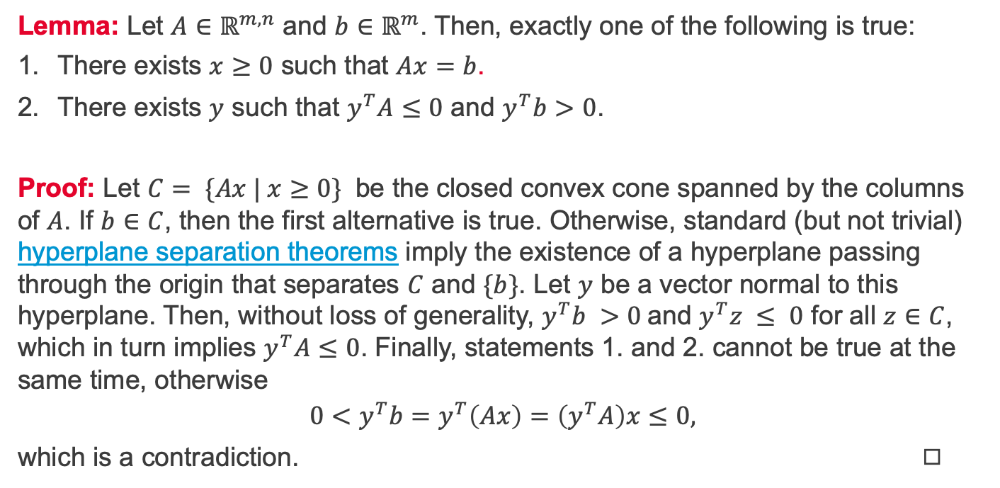
Farkas' lemma
Lemma: Let $A∈ℝ^{m,n}$ and $b∈ℝ^{m}$. Then, exactly one of the following is true:
There exists $x≥0$ such that $Ax=b$.
There exists $y$ such that $y^{T}A≤0$ and $y^{T}b>0$.
Proof: Let $C= \{Ax | x≥0\}$ be the closed convex cone spanned by the columns of $A$. If $b∈C$, then the first alternative is true. Otherwise, standard (but not trivial) hyperplane separation theorems imply the existence of a hyperplane passing through the origin that separates $C$ and $\{b\}$. Let $y$ be a vector normal to this hyperplane. Then, without loss of generality, $y^{T}b >0$and $y^{T}z ≤ 0$ for all $z∈C$, which in turn implies $y^{T}A≤0$. Finally, statements 1. and 2. cannot be true at the same time, otherwise
$$0<y^{T}b=y^{T}\left(Ax\right)=\left(y^{T}A\right)x≤0,$$
which is a contradiction. ◻︎

Slide 6
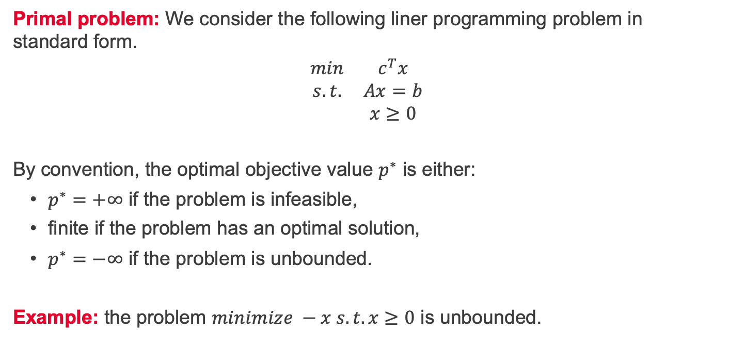
Duality – primal problem
Primal problem: We consider the following liner programming problem in standard form.
$$\begin{matrix}min & c^{T}x \\ s.t. & Ax=b \\ & x≥0\end{matrix}$$
By convention, the optimal objective value $p^{∗}$ is either:
$p^{∗}=+∞$ if the problem is infeasible,
finite if the problem has an optimal solution,
$p^{∗}=−∞$ if the problem is unbounded.
Example: the problem $minimize −x s.t. x≥0$ is unbounded.

Slide 7
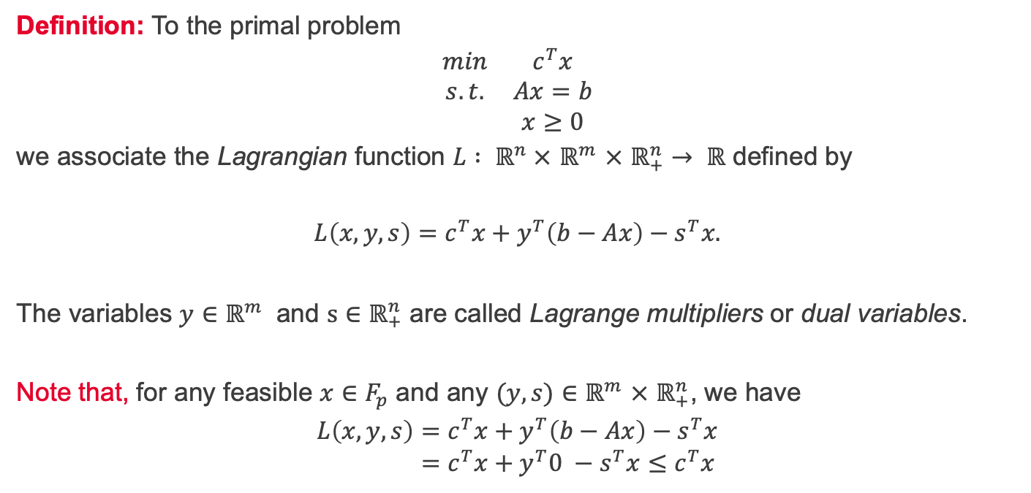
Duality – Lagrange function
Definition: To the primal problem
$$\begin{matrix}min & c^{T}x \\ s.t. & Ax=b \\ & x≥0\end{matrix}$$
we associate the Lagrangian function $L : ℝ^{n} ×$ $ℝ^{m}$ $×$ $ℝ_{+}^{n}→ ℝ$ defined by
$$L\left(x,y,s\right)=c^{T}x+y^{T}\left(b−Ax\right)−s^{T}x.$$
The variables $y∈ℝ^{m}$ and $s∈ℝ_{+}^{n}$ are called Lagrange multipliers or dual variables.
Note that, for any feasible $x∈F_{p}$ and any $(y,s)∈ℝ^{m}$ $×$ $ℝ_{+}^{n}$, we have
$$L\left(x,y,s\right)=c^{T}x+y^{T}\left(b−Ax\right)−s^{T}x \\ =c^{T}x+y^{T}0 −s^{T}x≤c^{T}x$$

Slide 8
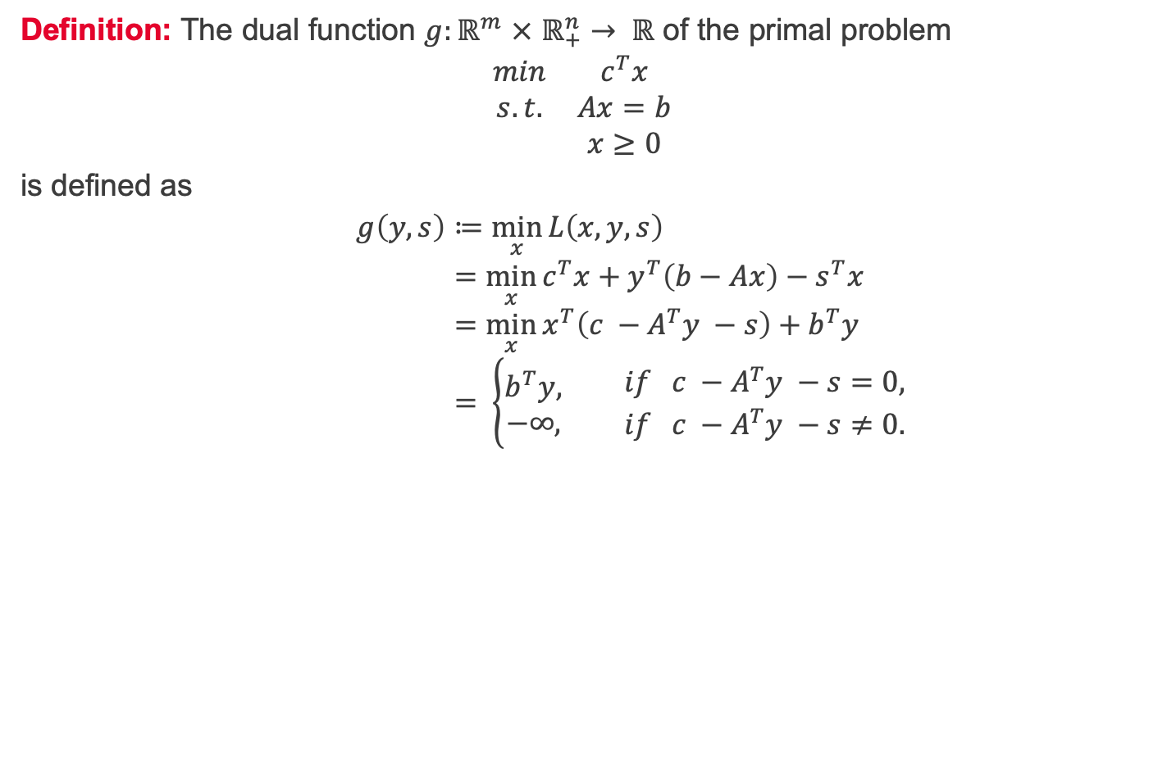
Duality – dual function
Definition: The dual function $g:ℝ^{m}$ $×$ $ℝ_{+}^{n}→ ℝ$ of the primal problem
$$\begin{matrix}min & c^{T}x \\ s.t. & Ax=b \\ & x≥0\end{matrix}$$
is defined as
$$g\left(y,s\right)≔\min_{x}{L\left(x,y,s\right)} \\ =\min_{x}{c^{T}x+y^{T}\left(b−Ax\right)−s^{T}x} \\ =\min_{x}{x^{T}\left(c −A^{T}y −s\right)+b^{T}y} \\ = \left\{\begin{aligned}b^{T}y, \\ −∞,\end{aligned} \begin{matrix}if c −A^{T}y −s=0, \\ if c −A^{T}y −s≠0.\end{matrix}\right.$$

Slide 9
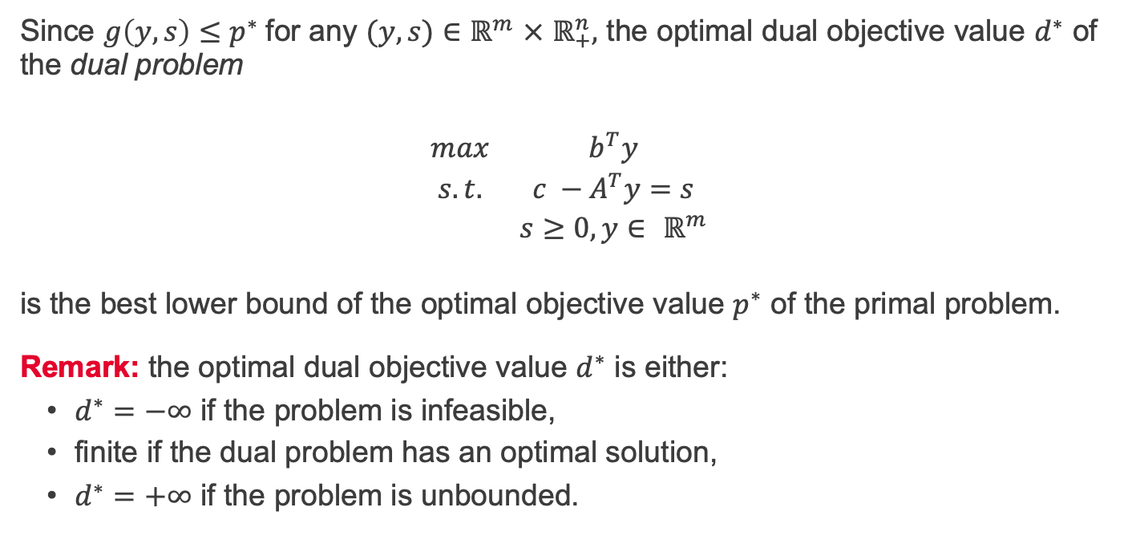
Duality – dual problem
Since $g\left(y,s\right)≤p^{∗}$for any $(y,s)∈$ $ℝ^{m}$ $×$ $ℝ_{+}^{n},$ the optimal dual objective value $d^{∗}$ of the dual problem
$$\begin{matrix}max & b^{T}y \\ s.t. & c −A^{T}y=s \\ & s≥0, y∈ ℝ^{m}\end{matrix}$$
is the best lower bound of the optimal objective value $p^{∗}$ of the primal problem. Remark: the optimal dual objective value $d^{∗}$ is either:
$d^{∗}=−∞$ if the problem is infeasible,
finite if the dual problem has an optimal solution,
$d^{∗}=+∞$ if the problem is unbounded.

Slide 10
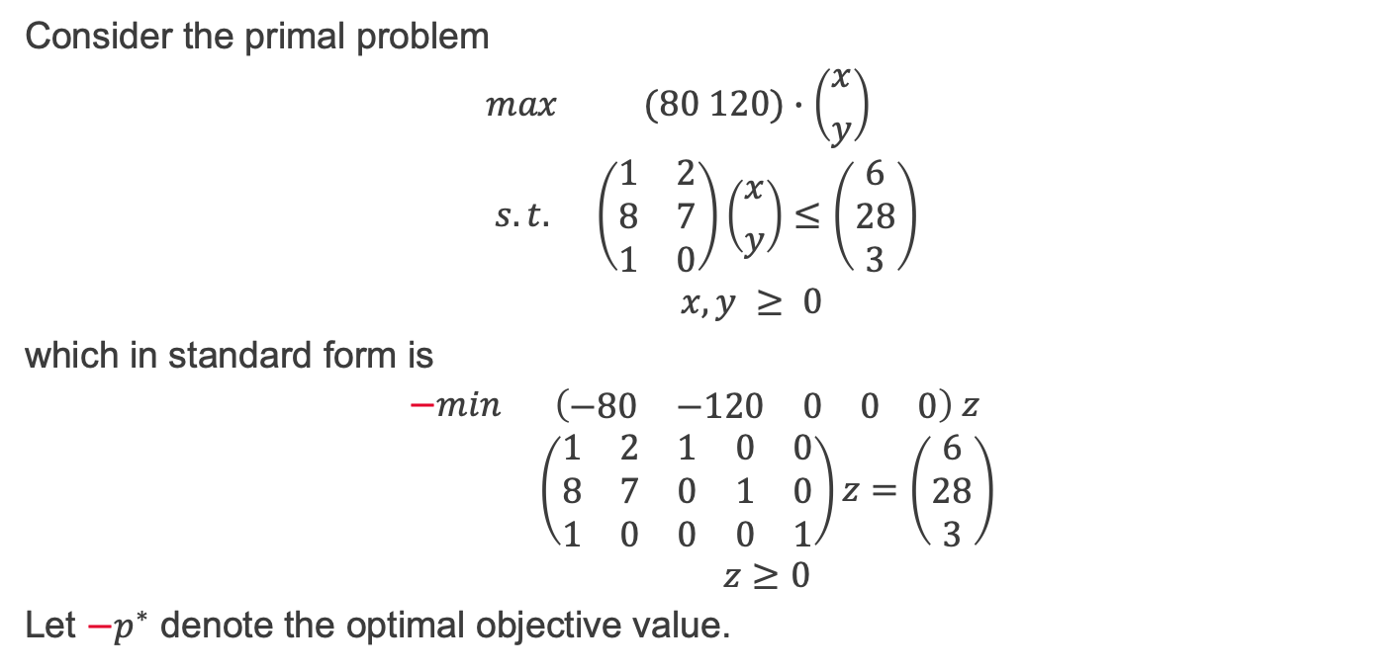
Duality – example 1/2
Consider the primal problem
$$\begin{matrix}max & (80 120)∙\left({x \atop y}\right) \\ s.t. & \left(\begin{matrix}1 & 2 \\ 8 & 7 \\ 1 & 0\end{matrix}\right)\left({x \atop y}\right)≤\left(\begin{matrix}6 \\ 28 \\ 3\end{matrix}\right) \\ & x,y ≥ 0 \end{matrix}$$
which in standard form is
$$\begin{matrix}−min & \left(\begin{matrix}−80 & −120 & 0 & 0 & 0\end{matrix}\right) z \\ & \left(\begin{matrix}1 & 2 & 1 & 0 & 0 \\ 8 & 7 & 0 & 1 & 0 \\ 1 & 0 & 0 & 0 & 1\end{matrix}\right)z=\left(\begin{matrix}6 \\ 28 \\ 3\end{matrix}\right) \\ & z≥0\end{matrix}$$
Let $−p^{∗}$ denote the optimal objective value.

Slide 11
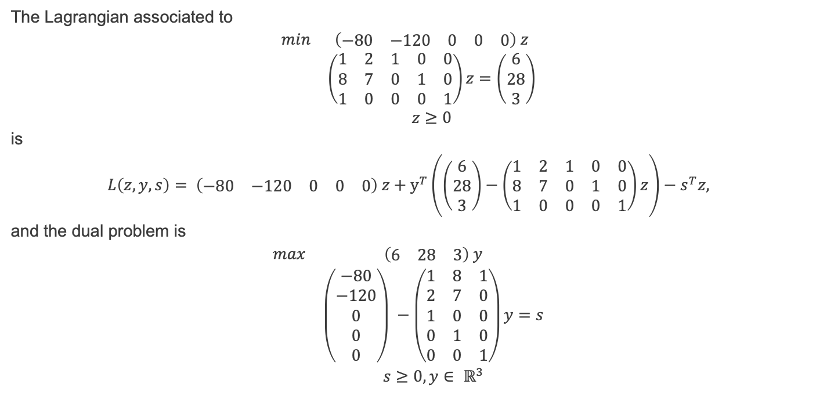
Duality – example 2/2
The Lagrangian associated to
$$\begin{matrix}min & \left(\begin{matrix}−80 & −120 & 0 & 0 & 0\end{matrix}\right) z \\ & \left(\begin{matrix}1 & 2 & 1 & 0 & 0 \\ 8 & 7 & 0 & 1 & 0 \\ 1 & 0 & 0 & 0 & 1\end{matrix}\right)z=\left(\begin{matrix}6 \\ 28 \\ 3\end{matrix}\right) \\ & z≥0\end{matrix}$$
is
$$L\left(z,y,s\right)= \left(\begin{matrix}−80 & −120 & 0 & 0 & 0\end{matrix}\right) z+y^{T}\left(\left(\begin{matrix}6 \\ 28 \\ 3\end{matrix}\right)−\left(\begin{matrix}1 & 2 & 1 & 0 & 0 \\ 8 & 7 & 0 & 1 & 0 \\ 1 & 0 & 0 & 0 & 1\end{matrix}\right)z\right)−s^{T}z,$$
and the dual problem is
$$\begin{matrix}max & \left(\begin{matrix}6 & 28 & 3\end{matrix}\right) y \\ & \left(\begin{matrix}−80 \\ −120 \\ 0 \\ 0 \\ 0\end{matrix}\right) −\left(\begin{matrix}1 & 8 & 1 \\ 2 & 7 & 0 \\ 1 & 0 & 0 \\ 0 & 1 & 0 \\ 0 & 0 & 1\end{matrix}\right)y=s \\ & s≥0,y∈ ℝ^{3}\end{matrix}$$

Slide 12
To be continued...

Slide 13

Duality – the dual of the dual 1/3
The dual of
$$\begin{matrix}min & c^{T}x \\ s.t. & Ax=b \\ & x≥0\end{matrix}$$
is
$$\begin{matrix}max & b^{T}y \\ s.t. & c −A^{T}y=s \\ & s≥0, y∈ ℝ^{m}\end{matrix},$$
which, we can also write as
$$\begin{matrix}max & b^{T}y \\ s.t. & c −A^{T}y≥0 \\ & y∈ ℝ^{m}\end{matrix}$$

Slide 14
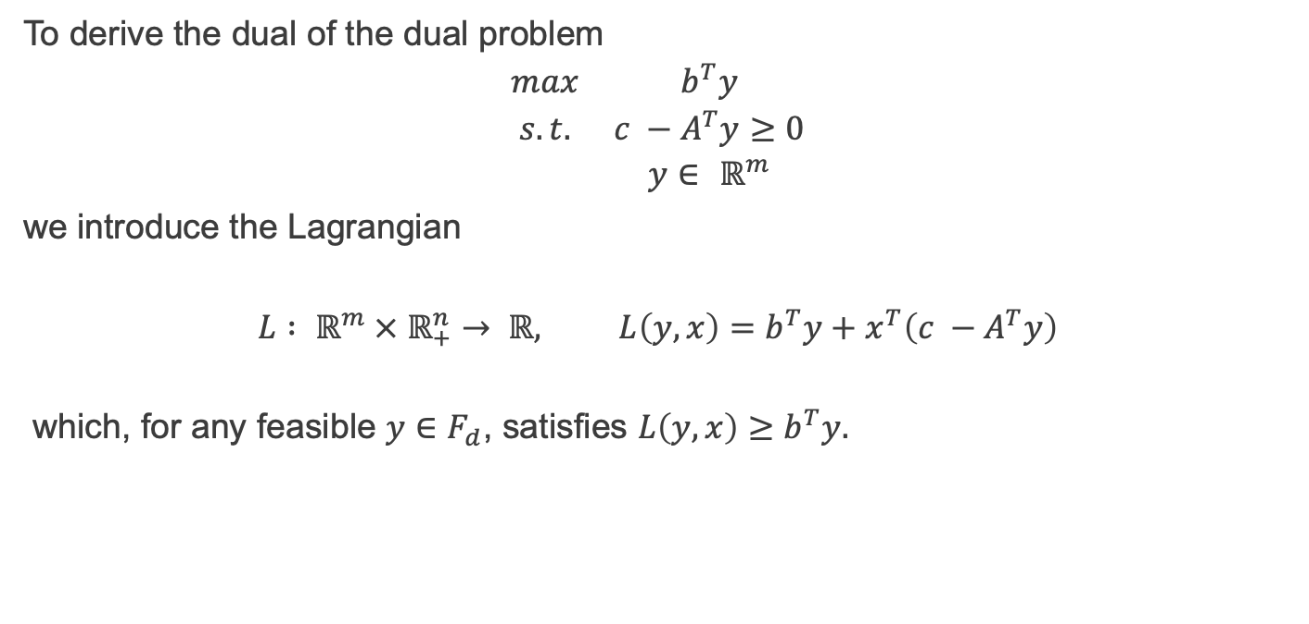
Duality – the dual of the dual 2/3
To derive the dual of the dual problem
$$\begin{matrix}max & b^{T}y \\ s.t. & c −A^{T}y≥0 \\ & y∈ ℝ^{m}\end{matrix}$$
we introduce the Lagrangian
$$L : ℝ^{m} × ℝ_{+}^{n}→ ℝ, L\left(y,x\right)=b^{T}y+x^{T}\left(c −A^{T}y\right)$$
which, for any feasible $y∈F_{d}$, satisfies $L\left(y,x\right)≥b^{T}y.$

Slide 15
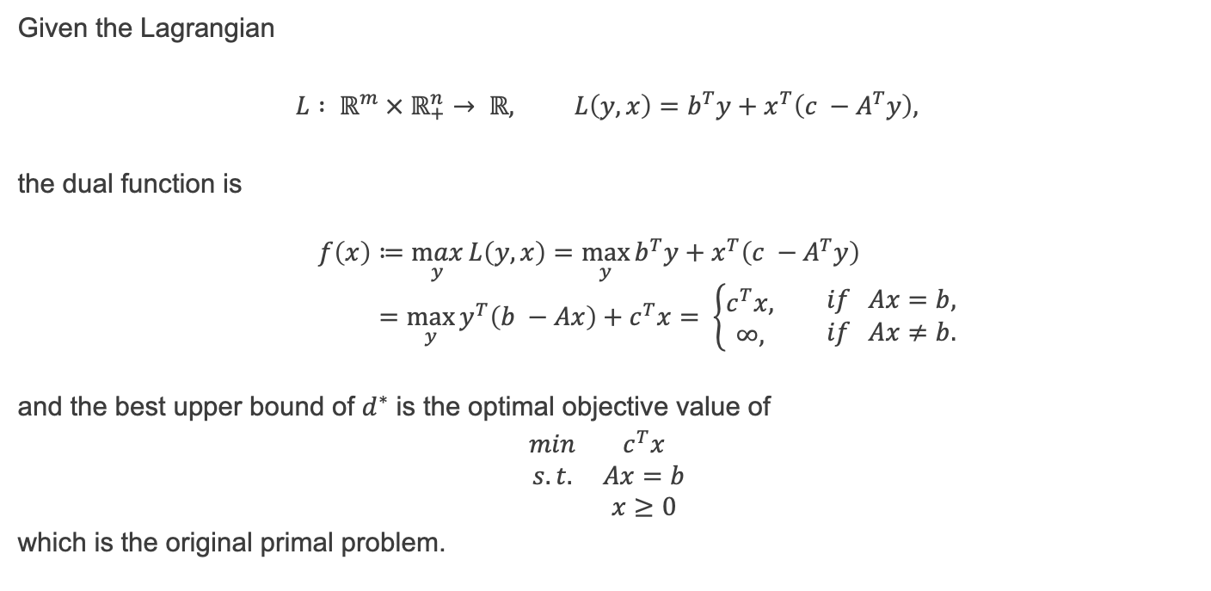
Duality – the dual of the dual 3/3
Given the Lagrangian
$$L : ℝ^{m} × ℝ_{+}^{n}→ ℝ, L\left(y,x\right)=b^{T}y+x^{T}\left(c −A^{T}y\right),$$
the dual function is
$$f\left(x\right)≔\max_{y}{L\left(y,x\right)}=\max_{y}{b^{T}y+x^{T}\left(c −A^{T}y\right)} \\ =\max_{y}{y^{T}\left(b −Ax\right)+c^{T}x}= \left\{\begin{aligned}c^{T}x, \\ ∞,\end{aligned} \begin{matrix}if Ax=b, \\ if Ax≠b.\end{matrix}\right.$$
and the best upper bound of $d^{∗}$ is the optimal objective value of
$$\begin{matrix}min & c^{T}x \\ s.t. & Ax=b \\ & x≥0\end{matrix}$$
which is the original primal problem.

Slide 16
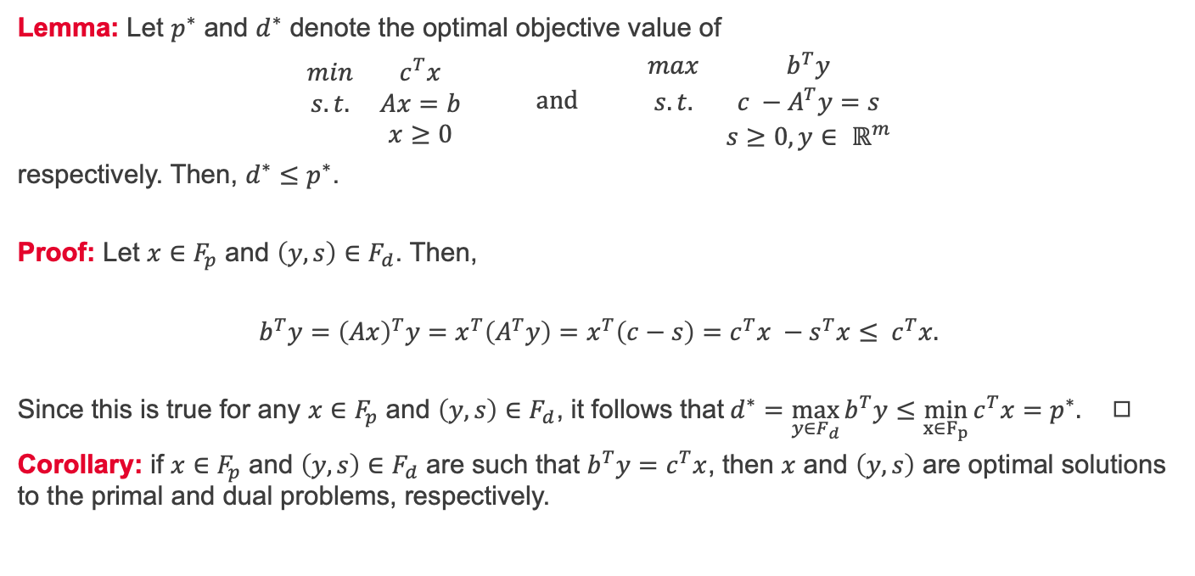
Weak duality
Lemma: Let $p^{∗}$ and $d^{∗}$ denote the optimal objective value of
$$\begin{matrix}min & c^{T}x \\ s.t. & Ax=b \\ & x≥0\end{matrix} and \begin{matrix}max & b^{T}y \\ s.t. & c −A^{T}y=s \\ & s≥0, y∈ ℝ^{m}\end{matrix}$$
respectively. Then, $d^{∗}≤p^{∗}$.
Proof: Let $x∈F_{p}$ and $\left(y,s\right)∈F_{d}$. Then,
$$b^{T}y={\left(Ax\right)}^{T}y=x^{T}\left(A^{T}y\right)=x^{T}\left(c−s\right)=c^{T}x −s^{T}x≤ c^{T}x.$$
Since this is true for any $x∈F_{p}$ and $\left(y,s\right)∈F_{d}$, it follows that$d^{∗}=\max_{y∈F_{d}}{b^{T}y}≤\min_{x∈F_{p}}{c^{T}x}=p^{∗}.$ ◻︎
Corollary: if $x∈F_{p}$ and $\left(y,s\right)∈F_{d}$ are such that $b^{T}y=c^{T}x$, then $x$ and $\left(y,s\right)$ are optimal solutions to the primal and dual problems, respectively.

Slide 17
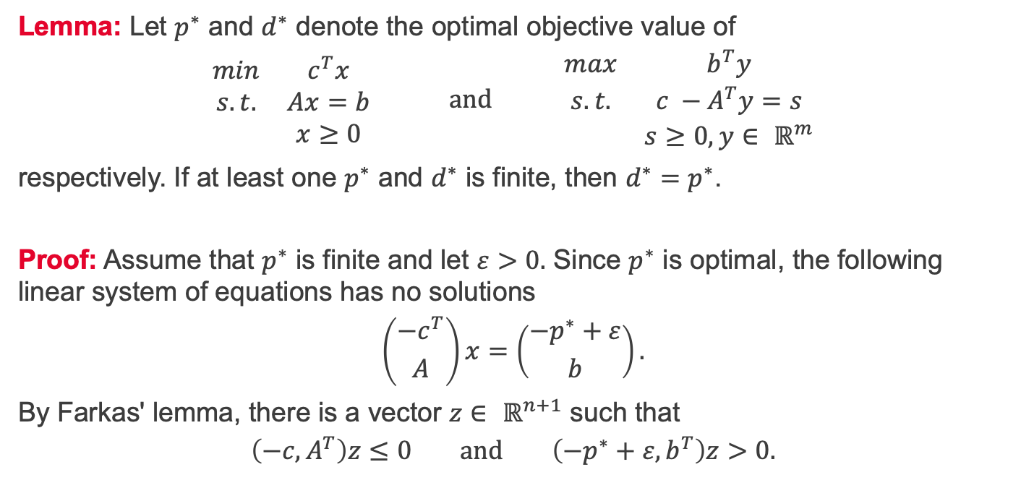
Strong duality 1/3
Lemma: Let $p^{∗}$ and $d^{∗}$ denote the optimal objective value of
$$\begin{matrix}min & c^{T}x \\ s.t. & Ax=b \\ & x≥0\end{matrix} and \begin{matrix}max & b^{T}y \\ s.t. & c −A^{T}y=s \\ & s≥0, y∈ ℝ^{m}\end{matrix}$$
respectively. If at least one $p^{∗}$ and $d^{∗}$ is finite, then $d^{∗}=p^{∗}$.
Proof: Assume that $p^{∗}$ is finite and let $ε>0.$ Since $p^{∗}$ is optimal, the following linear system of equations has no solutions
$$\left({−c^{T} \atop A}\right)x=\left({−p^{∗}+ε \atop b}\right).$$
By Farkas' lemma, there is a vector $z∈ ℝ^{n+1}$ such that
$$\left(−c, A^{T}\right)z≤0 and \left(−p^{∗}+ε, b^{T}\right)z>0.$$

Slide 18
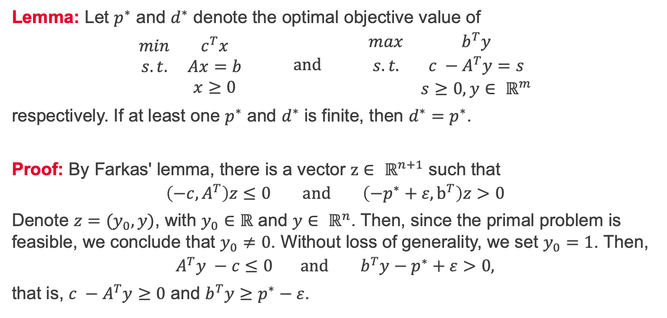
Strong duality 2/3
Lemma: Let $p^{∗}$ and $d^{∗}$ denote the optimal objective value of
$$\begin{matrix}min & c^{T}x \\ s.t. & Ax=b \\ & x≥0\end{matrix} and \begin{matrix}max & b^{T}y \\ s.t. & c −A^{T}y=s \\ & s≥0, y∈ ℝ^{m}\end{matrix}$$
respectively. If at least one $p^{∗}$ and $d^{∗}$ is finite, then $d^{∗}=p^{∗}$.
Proof: By Farkas' lemma, there is a vector $z∈ ℝ^{n+1}$ such that
$$\left(−c, A^{T}\right)z≤0 and \left(−p^{∗}+ε, b^{T}\right)z>0$$
Denote $z=(y_{0}, y)$, with $y_{0}∈ℝ$ and $y∈ ℝ^{n}$. Then, since the primal problem is feasible, we conclude that $y_{0}≠0$. Without loss of generality, we set $y_{0}=1$. Then,
$$A^{T}y −c≤0 and b^{T}y−p^{∗}+ε>0,$$
that is, $c −A^{T}y≥0$ and $b^{T}y≥p^{∗}−ε$.

Slide 19
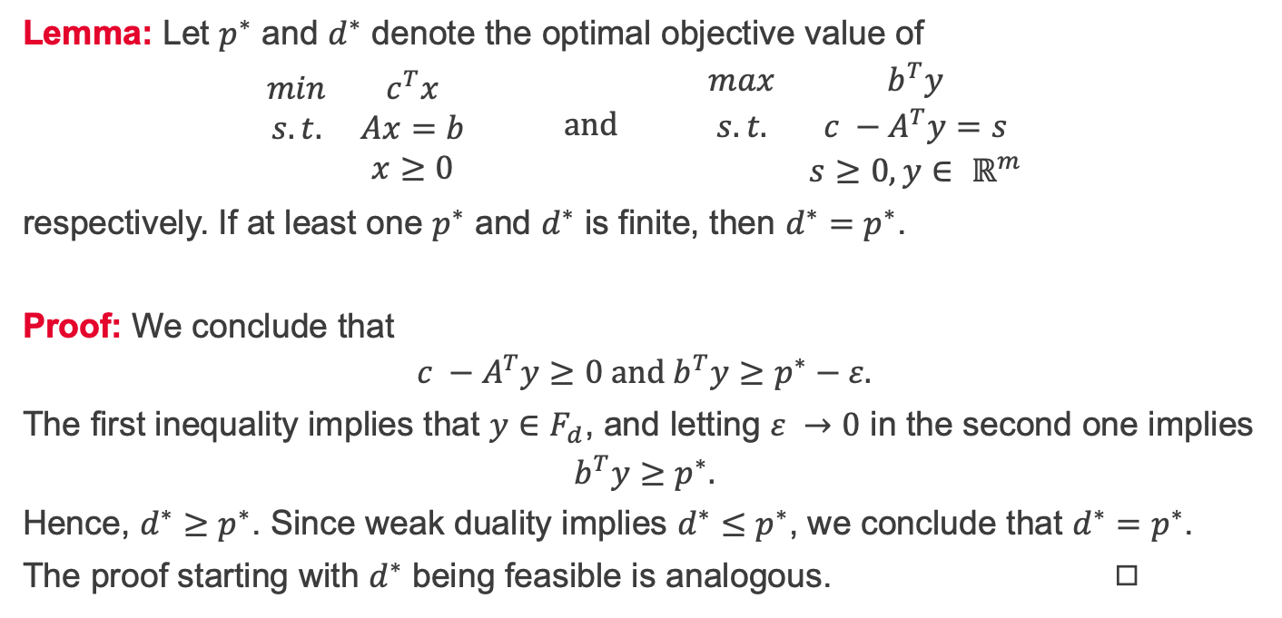
Strong duality 3/3
Lemma: Let $p^{∗}$ and $d^{∗}$ denote the optimal objective value of
$$\begin{matrix}min & c^{T}x \\ s.t. & Ax=b \\ & x≥0\end{matrix} and \begin{matrix}max & b^{T}y \\ s.t. & c −A^{T}y=s \\ & s≥0, y∈ ℝ^{m}\end{matrix}$$
respectively. If at least one $p^{∗}$ and $d^{∗}$ is finite, then $d^{∗}=p^{∗}$.
Proof: We conclude that
$$c −A^{T}y≥0 and b^{T}y≥p^{∗}−ε.$$
The first inequality implies that $y∈F_{d}$, and letting $ε →0$ in the second one implies
$$b^{T}y≥p^{∗}.$$
Hence, $d^{∗}≥p^{∗}$. Since weak duality implies $d^{∗}≤p^{∗}$, we conclude that $d^{∗}=p^{∗}$.
The proof starting with $d^{∗}$ being feasible is analogous. ◻︎

Slide 20
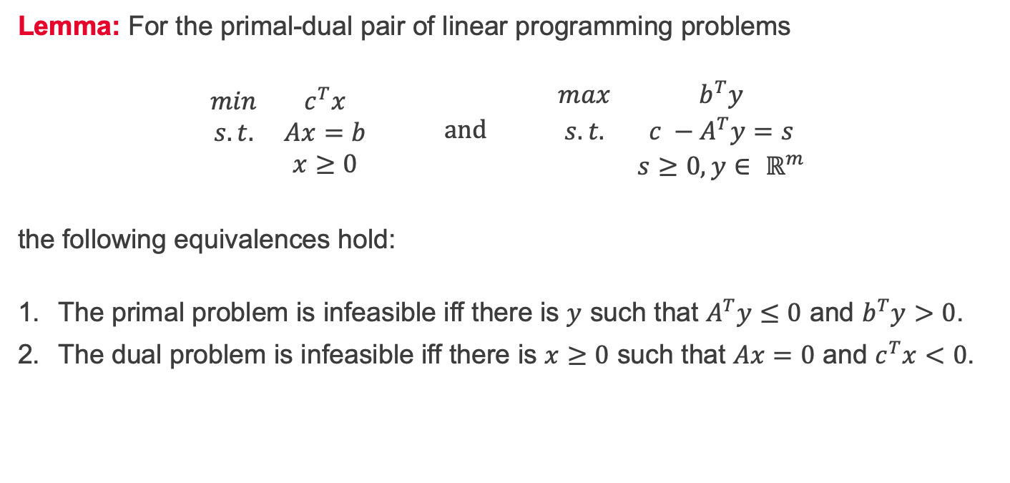
Primal and dual Farkas' lemma
Lemma: For the primal-dual pair of linear programming problems
$$\begin{matrix}min & c^{T}x \\ s.t. & Ax=b \\ & x≥0\end{matrix} and \begin{matrix}max & b^{T}y \\ s.t. & c −A^{T}y=s \\ & s≥0, y∈ ℝ^{m}\end{matrix}$$
the following equivalences hold:
The primal problem is infeasible iff there is $y$ such that $A^{T}y≤0$ and $b^{T}y>0$.
The dual problem is infeasible iff there is $x≥0$ such that $Ax=0$ and $c^{T}x<0$.

Slide 21
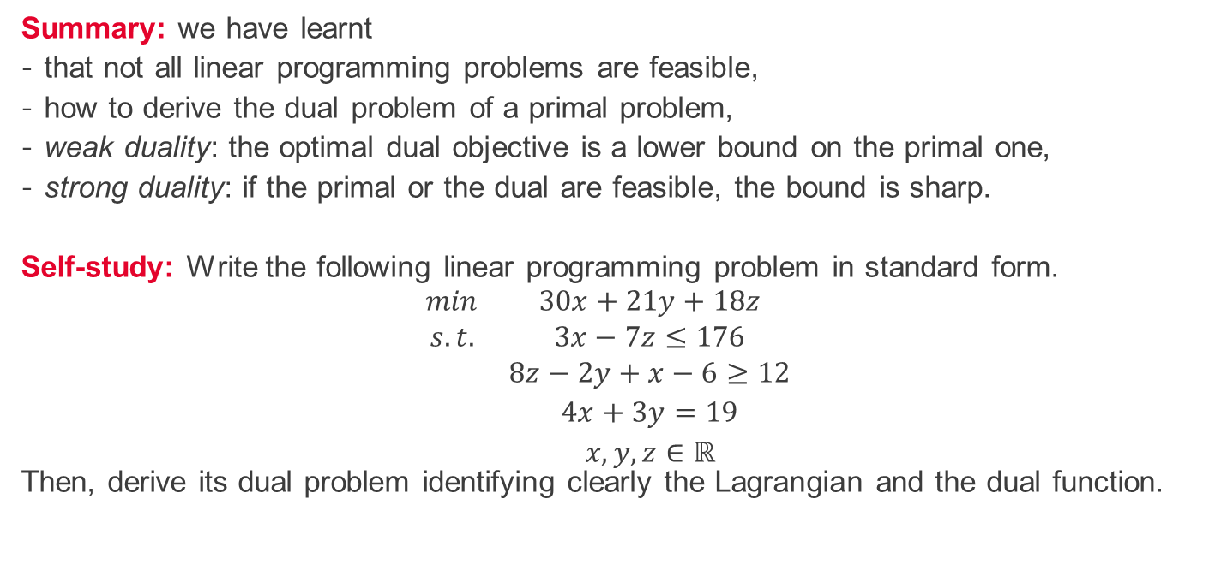
Summary and self-study
Summary: we have learnt
that not all linear programming problems are feasible,
how to derive the dual problem of a primal problem,
weak duality: the optimal dual objective is a lower bound on the primal one,
strong duality: if the primal or the dual are feasible, the bound is sharp.
Self-study: Write the following linear programming problem in standard form. $$\begin{matrix}min & 30x+21y+18z \\ s.t. & 3x−7z≤176 \\ & 8z−2y+x−6≥12 \\ & 4x+3y=19 \\ & x,y, z∈ℝ\end{matrix}$$
Then, derive its dual problem identifying clearly the Lagrangian and the dual function.

